Slide 1

Notes:
Hello and Welcome,

Slide 2



01
Philip Lafleur
Data Analyst
Skilled Training Specialist with 6 years of experience in conducting personal and group training sessions focused on Critical Roles. Enthusiastic personality with a hands-on, creative style.
Notes:
I am a skilled and experienced training specialist with over 6 years of hands-on experience in conducting personal and group training sessions, particularly focused on critical operational roles. With an enthusiastic personality and creative teaching style, I excel at designing comprehensive curricula, instructional materials, and assessments to effectively train and develop workforces.
Throughout my career I have demonstrated expertise in areas such as monitoring and reporting KPIs, implementing new processes, conducting research and presenting findings, as well as providing leadership and consultancy to drive improvements in employee growth, productivity, and retention rates.
In addition to my training expertise, Iam about to finish this Data Analyst bootcamp, equipping me with skills in data analysis, SQL querying, data visualization, and problem-solving. This unique combination of training experience and analytical capabilities allows me to bring a data-driven approach for optimizing.

Slide 3







Amazon
Prime User Analysis

Slide 4
STAKEHOLDER

Slide 5



02
STAKEHOLDER
Jane Smith
Chief Marketing Officer at Amazon Prime
Jane is responsible for driving customer acquisition, retention, and engagement strategies for Amazon Prime.
Notes:
Ai generated image
Her primary goals are to increase Prime membership, boost customer loyalty, and maximize the lifetime value of Prime subscribers.
Her team provided this dataset and we were hired to give her some recommendations to reach her goal.

Slide 6
EDA

Slide 7


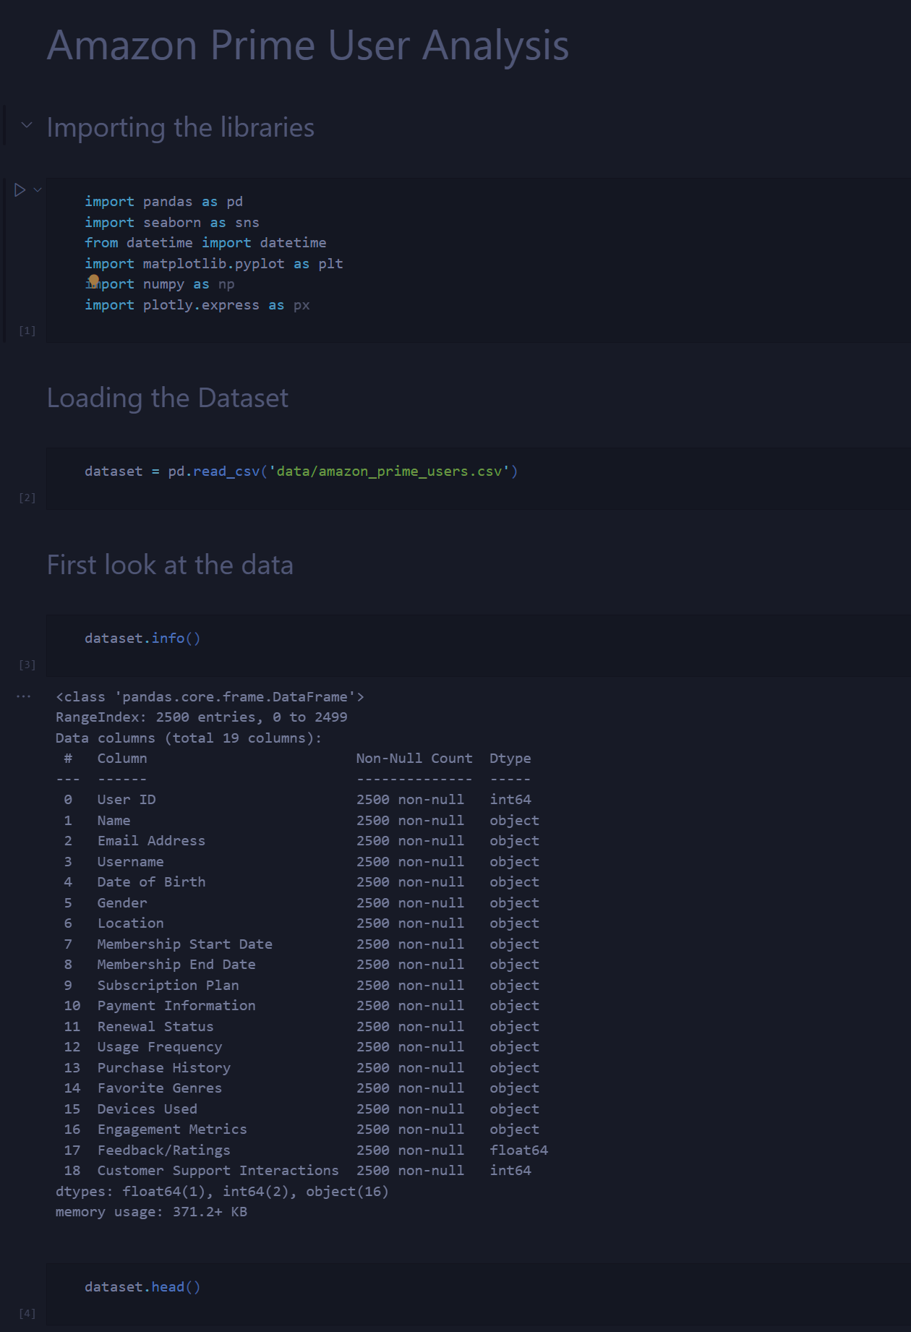
03
EDA
This dataset contains 19 columns with 2500 entries
The dataset includes the following key variables:
Date of Birth
Favorite genre
Usage Frequency
Devices Used
Customer Support Feedback
Payment and Purchase Categories
Engagement Metrics
Notes:
Favorite genre:
Preferred genres of users in 7 Categories
Usage Frequency:
Frequency of Amazon Prime usage
categorized into Frequent, Regular, and Occasional
Devices Used:
Types of devices used to access Amazon Prime, including Smartphones, Smart TVs, and Tablets
Customer Support Feedback:
Feedback ratings and interactions with customer support
Payment and Purchase Categories:
Information on payment methods and purchase categories including subscriptions and renewals
Engagement Metrics:
Levels of user engagement categorized as High, Medium, and Low

Slide 8

Data Visualization

Slide 9

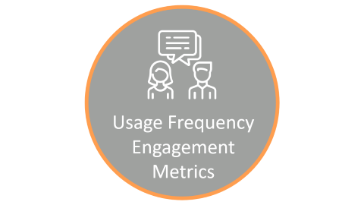
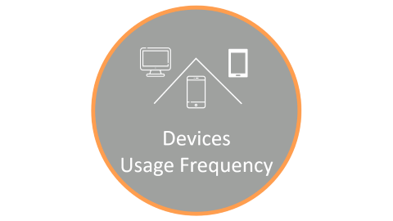
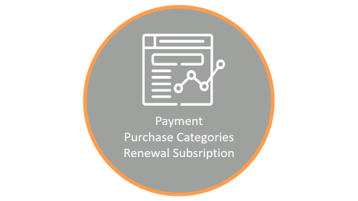

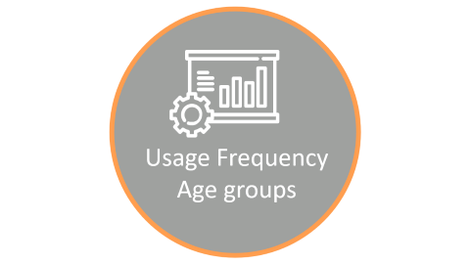

04
Data Visualization

Slide 10

Age
Favourite Genre

Slide 11
05
Data Visualization
Distribution of Age
Favourite Genres
18 - 34
35 - 54
55 - 74
75+

Slide 12
06
Data Visualization
Favourite Genre by Age Groups
18 - 34
35 - 54
55 - 74
75+
Sci-Fi
Romance
Romance
Horror
Horror
Horror
Horror
Horror
Drama
Drama
Documentary
Documentary
Comedy
Comedy
Comedy
Action
Action
Action
Action
Notes:
Top 3 for 18 – 34 :Horror, Action, Comedy
Top 3 for 35 – 54 : Horror, Documentary, Comedy
Top 3 for 55 - 74 : Romance, Action, Horror
Top 3 for 75+ : Action, Drama, Documentary
The analysis shows that user preferences change with age.
Overall, Horror emerges as a popular genre across all age groups, particularly Middle Age and Young Adults, suggesting a broad appeal for the genre's suspense and excitement. Conversely, Romance is significantly favored by Eldery Adults, indicating a possible generational inclination towards more emotionally driven content.

Slide 13
Usage Frequency
Age groups

Slide 14

07
Data Visualization
Usage Frequency
by Age groups
Usage Frequency
Notes:
Interestingly, the median ages of users who are occasional, regular, and frequent are quite similar, with only slight differences.
This analysis shows a more balanced relationship between how often people use the platform and their age than expected.
This finding suggests we need to rethink our assumptions about user engagement.
It highlights the importance of thoroughly understanding user demographics to create better strategies for engaging users and improving the platform.

Slide 15
Usage Frequency
Engagement Metrics

Slide 16
08
Data Visualization
Usage Frequency
Engagement Metrics

Slide 17
09
Data Visualization
Engagement Metrics by Usage Frequency
Occaisonal
Regular
Frequent
31,5
34,3
%
%
34,5
%
33,1
33,5
32,0
%
%
%
33,6
33,4
33,9
%
%
%
Low
Medium
High
Notes:
This balance indicates that engagement levels stay quite steady regardless of how often people interact.
Though there are small differences between frequency categories, like a slightly higher percentage
of people with "Low" engagement in the "Occasional" category compared to "Frequent" and "Regular," these variations are not significant.

Slide 18

Devices
Usage Frequency

Slide 19
10
Data Visualization
Devices Used by
Usage Frequency
Devices Used
Smartphone
Smart Tv
Tablet
Notes:
Occasional and regular users exhibit a more uniform distribution of device usage, with marginal differences observed across device categories.
While these user segments also engage with the platform across multiple devices, their usage patterns appear to be less diversified compared to frequent users.

Slide 20
Customer Support
Feedback

Slide 21
11
Data Visualization
Customer Support interactions
Feedback ratings

Slide 22
12
Data Visualization
Impact of Customer Support Interactions on Feedback Ratings
3 – 3,4
3,4 – 3,9
4 – 4,4
4,4 – 4,9
5
Notes:
This observation highlights how important customer support is in shaping user experiences and perceptions.
Positive and effective support often leads to higher feedback ratings, showing that users are satisfied and trust the platform's services.
On the other hand, negative or poor support experiences tend to result in lower feedback ratings, indicating user dissatisfaction and potential issues that need to be addressed.

Slide 23
Payment
Purchase Categories
Renewal Subsription

Slide 24
13
Data Visualization
Renewal Subscription
Payment Method
Categories
Mastercard
Clothing
Amex
Electronics
Manual
Auto-renew
Books
Visa
Notes:
Mastercard has a slight edge over Visa and Amex, showing a competitive market with various payment options.
This distribution highlights the diverse preferences and adoption rates among users.
Similarly, auto-renew is just slightly more popular than manual renewal, indicating a close competition between the two methods.
Users have different preferences based on factors like convenience, flexibility, and control over their subscriptions.

Slide 25
14
Data Visualization
Renewal Subscription by Age groups
18 - 34
35 - 54
55 - 74
75+
Notes:
The data shows that preferences for auto-renewal versus manual renewal of subscriptions vary by age group.
Young adults and middle-aged individuals prefer auto-renewal slightly more than manual renewal.
In contrast, elderly adults and seniors have a more balanced preference between the two.
This suggests that while younger and middle-aged people lean towards the convenience of auto-renewal, older adults are nearly equally split.
Understanding these trends can help in designing subscription models and marketing strategies that cater to the preferences of each age group.

Slide 26
Recommendation

Slide 27


15
Recommendation
Target Younger Demographics (18-34 years old)
Enhance Mobile Experience
Leverage Customer Support Interactions
Offer Flexible Payment Options
Implement Personalized Recommendations
Notes:
Target Younger Demographics (18-34 years old)
The data shows that this age group has a higher preference for genres like horror, sci-fi, and action.
Curate and promote content tailored to these genres to attract and retain younger Prime subscribers
Enhance Mobile Experience: A significant portion of Prime users, especially those with frequent usage, access the service through smartphones.
Optimize the mobile app and ensure a seamless user experience across different devices to cater to this segment
Leverage Customer Support Interactions: The analysis indicates a positive correlation between customer
support interactions and higher feedback ratings. Prioritize prompt and effective customer support to improve
overall satisfaction and retention rates.
Offer Flexible Payment Options: While auto-renewal subscriptions are popular, a considerable
number of users prefer manual payment methods like credit cards. Provide a range of payment options
to accommodate diverse preferences and improve the checkout experience.
Implement Personalized Recommendations: The data reveals varying preferences across age groups and usage frequencies. Leverage advanced recommendation algorithms to deliver personalized content suggestions based on individual user profiles, enhancing engagement and customer loyalty.

